Slide 1
Gearbox Failure Prediction in Wind Turbines
By
Harshavardhan Reddy Dhoma
Jagadeesh Kovi
Suraj Vamshi Muthyam

Slide 2
AGENDA
Introduction
Project Goals
Importance of the Project
Previous Work
Methods

Slide 3
AGENDA
Model Selection
Next Steps
Conclusion
Q&A

Slide 4
Introduction
Wind turbines, crucial for renewable energy, face frequent unplanned failures, causing downtime and reduced energy output.
Our project focuses on developing a precise Failure Forecasting model, particularly for predicting Gearbox failures in wind turbines.
Using machine learning and historical data, our goal is to anticipate Gearbox failures, enabling proactive maintenance strategies.
By minimizing unexpected interruptions and optimizing energy production, we aim to enhance wind turbine reliability and efficiency, contributing to a cleaner, eco-friendly energy landscape.

Slide 5
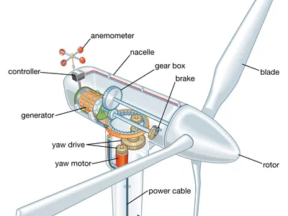
The gearbox of a wind turbine is a critical component that plays a pivotal role in the overall functionality and efficiency of the system.

Slide 6
Project Goals
Objective: Develop an effective Failure Forecasting model specifically tailored for predicting Gearbox failures in wind turbines.
Methodology: Utilize advanced machine learning techniques to enhance the accuracy of failure predictions.
Focus Area: The primary goal is to leverage historical data and insights gained from machine learning to anticipate and mitigate Gearbox failures.

Slide 7
Importance of the Project
Impact of Unplanned Failures
Operational Disruptions: Unplanned failures in wind turbines result in operational downtime, disrupting the continuous generation of energy.
Reduced Energy Output: Such failures lead to a decrease in energy production, impacting the overall efficiency and output of wind energy systems.
Economic Consequences: The financial implications of unplanned failures include costly repairs and potential revenue losses due to decreased power generation.

Slide 8
Importance of the Project
Importance of Proactive Maintenance and Influencing Factors
Proactive Maintenance Strategies: Proactive maintenance is crucial to reduce downtime caused by unplanned failures, ensuring consistent energy production.
Optimizing Energy Production: By considering influencing factors such as temperature variations, wind direction, and Yaw angle, we can implement precise maintenance strategies to optimize energy production.
Predictive Analytics Significance: Predicting failures based on these factors allows for a strategic approach to maintenance, reducing unexpected interruptions and enhancing overall system reliability.

Slide 9
Previous Work
1. Statistical Learning Approaches:
Focus: Emphasis on statistical learning-based approaches for fault diagnosis and anomaly detection.
Relevance: Provides insights into established methods for identifying faults in systems, serving as a foundation for our project.
2. Vibration Effects on Gearbox Failure:
Key Aspect: Explores the effects of vibration on gearbox failures.
Importance: Understanding the impact of vibration on failure modes is crucial for our Failure Forecasting model's accuracy.

Slide 10
Previous Work
3. Experimental Methods for Bearing Analysis:
Primary Methods: Focuses on SEM imaging, nanoindentation, and Hertzian stress calculations.
Relevance: The experimental methods detailed in this paper inform the development of our machine learning algorithms by providing insights into damage analysis and failure modes in bearings.
Research Integration:
Approach: We refer to the mentioned research (1, 2, 3) to integrate proven methodologies and findings into the development of our machine learning algorithms.
Enhancement: Leveraging insights from these studies enhances the robustness and effectiveness of our Failure Forecasting model.

Slide 11
Dataset Description
Wind speed (m/s): The survival speed of commercial wind turbines. Wind speed describes how fast the air is moving past a certain point.
Power (kW): Power output of wind turbine. Wind power describes the process by which the wind is used to generate mechanical power or electricity.
Gear oil, Ambient, Nacelle, Bearing, Wheel Hub Temperatures
Rotor Speed: Rotational speed of a wind turbine rotor about its axis. Part of the turbine's drivetrain, the low-speed shaft is connected to the rotor and spins between 8–20 rotations per minute.
Wind direction: The direction of the wind in degrees.
Generator Speed: The rotational speed required by most generators to produce electricity. a speed that allows the turbine's generator to produce AC electricity.

Slide 12
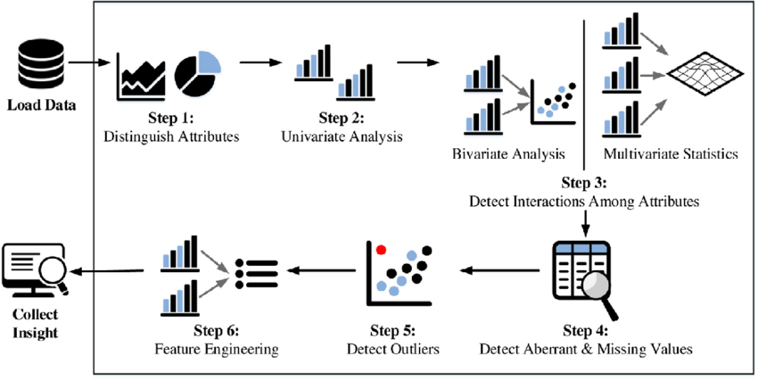
EDA

Slide 13
EDA
Observed that all variables are same data type i.e., float except Failure_status
Observed that only few features are strongly correlated.
Identified missing values and no duplicate values.
Observed outliers are present in all columns except Wheel_hub temperature.

Slide 14
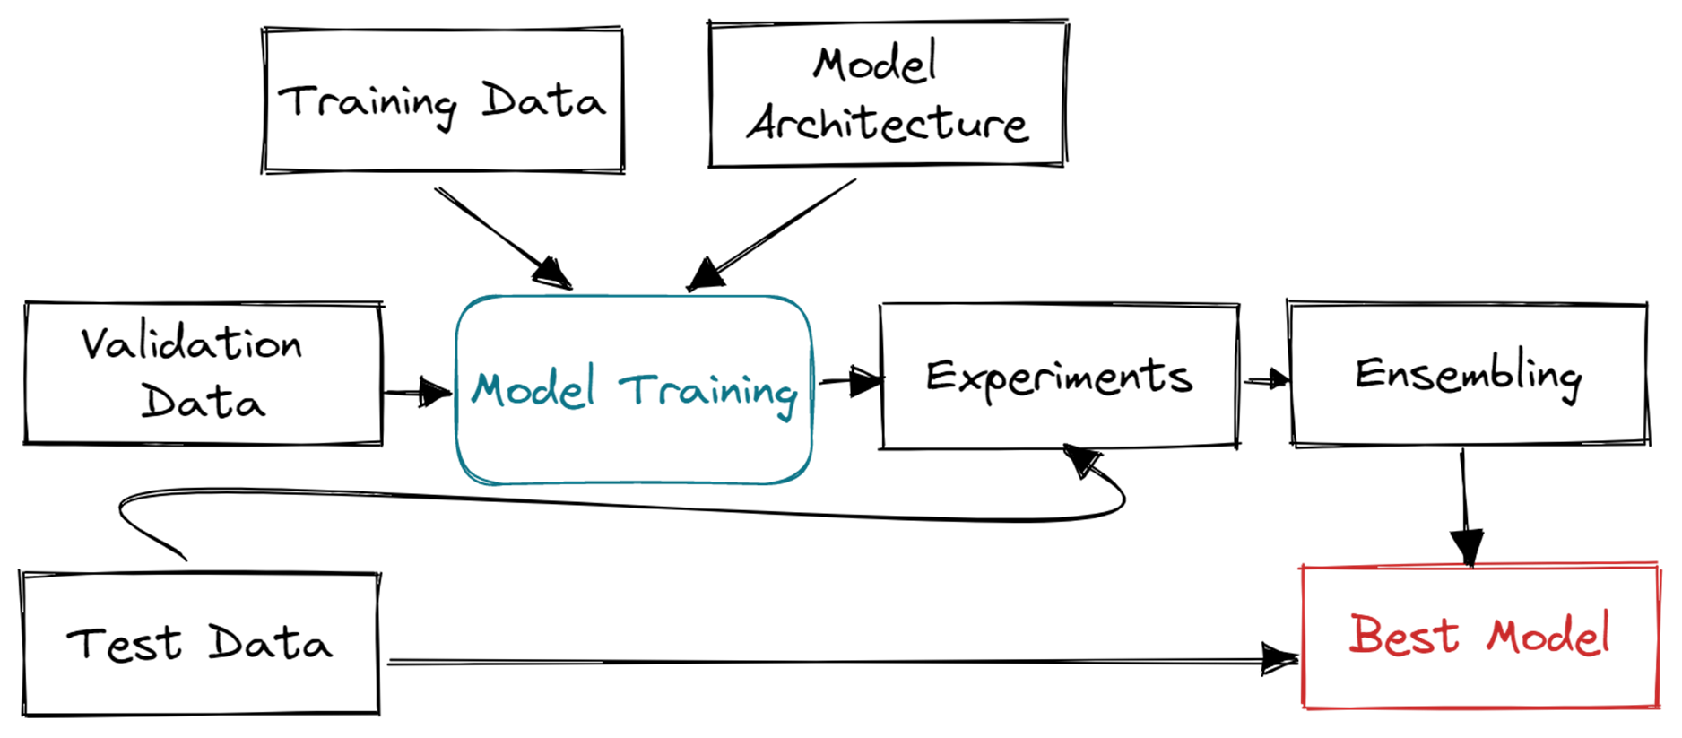
Methods and Model Selection

Slide 15
Methods and Model Selection
Experimentation with Multiple Models:
Current Status: Actively experimenting with various machine learning algorithms.
Diversity: Considering a range of models, including Naive Bayes, SVM, KNN, Decision Trees, Random Forest, and Logistic Regression.
Iterative Process: Ongoing experimentation allows us to assess the strengths and weaknesses of each algorithm.
Thorough Performance Evaluation:
Key Criterion: Performance evaluation is conducted rigorously to determine the effectiveness of each model.
Metrics: Employing relevant metrics such as precision, recall, and F1-score to assess the model's predictive capabilities.
Iterative Assessment: Iteratively evaluating models ensures a comprehensive understanding of their strengths and areas for improvement.

Slide 16
Results
Model Training Accuracy Testing Accuracy
Naive Bayes 0.973 0.9551
SVM 0.83 0.819
KNN 0.89173 0.8724
Decision Tree 0.96 0.92
Random Forest 0.9463 0.9413
Logistic Regression 0.89 0.886

Slide 17
Next Steps
Ongoing Hyperparameter Tuning:
Current Focus: Hyperparameter tuning is an integral part of our model development process.
Importance: Fine-tuning hyperparameters ensures optimal performance of the chosen algorithm.
Iterative Optimization: Continuously refining hyperparameters to enhance the model's accuracy and generalization capabilities.
Future Steps:
Further Experimentation: Continued experimentation with different models and algorithms.
Hyperparameter Refinement: Ongoing refinement of hyperparameters for optimization.
Comprehensive Evaluation: Ensuring the chosen model aligns with our project's goals for accurate forecasting of Gearbox failures.
Integrating with Flask

Slide 18



